Slide 1
Chapter 5
How to test and debug a program

Slide 2
Applied objectives
Plan the test runs for a program.
Trace the execution of a program with print() functions.
Use top-down coding and testing to simplify debugging.
Use the IDLE shell to test the functions of your programs and modules.
Use the IDLE debugger to set breakpoints, step through the statements of a program, and view the values of the data items at each step.
Use IDLE to view the stack for a program when an exception occurs.

Slide 3
Knowledge objectives
Distinguish among syntax, runtime, and logic errors.
Distinguish between testing and debugging.
Describe the process of tracing the execution of a program with print() functions.
Describe top-down coding and testing.
Describe the use of the IDLE shell for testing the functions of a program or module.
Describe the use of breakpoints and the IDLE debugger for stepping through a program.
Describe the use of the stack when a program exception occurs.
Describe the debugging problems that can occur when you use floating-point numbers in arithmetic expressions.

Slide 4
The Future Value program with a logic error
Enter monthly investment: 100
Enter yearly interest rate: 12
Enter number of years: 10
Future value: 22903.87
Continue? (y/n):

Slide 5
The goal of testing
To find all errors before the program is put into production.
The goal of debugging
To fix all errors before the program is put into production.

Slide 6
The three types of errors that can occur
Syntax errors violate the rules for how Python statements must be written. These errors, also called compile-time errors, are caught by IDLE and the Python compiler before you run the program.
Runtime errors don’t violate the syntax rules, but they throw exceptions that stop the execution of the program. Many of these exceptions are due to programming errors that need to be fixed. But some exceptions need to be handled by the program so the program won’t crash.
Logic errors are statements that don’t cause syntax or runtime errors, but produce the wrong results. In the console for the Future Value program above, the future value isn’t correct, which is a logic error.

Slide 7
A Python function that contains errors
def calculate_future_value(monthly_investment,
yearly_interest, years):
# convert yearly values to monthly values
monthly_interest_rate = yearly_interest / 12 / 100
months = years * 12
# calculate future value
future_value = 0.0
for i in range(1, months)
future_value += monthly_investment_amount
monthly_interest =
future_value * monthly_interest_rate
future_value += monthly_interest
return future_value

Slide 8
Common syntax errors
Misspelling keywords.
Forgetting the colon at the end of the opening line of a function definition, if clause, else clause, while statement, for statement, try clause, or except clause.
Forgetting an opening or closing quotation mark or parenthesis.
Using parentheses when you should be using brackets, or vice versa.
Improper indentation.

Slide 9
Problems with names and values
Misspelling or incorrectly capitalizing a variable or function name.
Using a keyword as a variable or function name.
Not checking that a value is the right data type before processing it. For example, using a number when it needs to be converted to a string, or vice versa.

Slide 10
Problem with floating-point arithmetic
The float data type in Python uses floating-point numbers, and that can lead to arithmetic results that are imprecise. For example,
sales_amount = 74.95;
discount = sales_amount * .1 # 7.495000000000001
One way to fix this problem is to round the result to the right number of decimal places. If necessary, you can also convert it back to a floating-point number:
discount = round(discount, 2) # 7.5
Another way to fix this problem is to use the standard decimal module, which lets you work with decimal numbers instead of floating-point numbers. You’ll learn how to use this module in chapter 9.

Slide 11
The Miles Per Gallon program with valid data
Enter miles driven: 320
Enter gallons of gas used: 10
Miles Per Gallon: 32.0
Continue? (y/n): y
Enter miles driven: 325
Enter gallons of gas used: 10
Miles Per Gallon: 32.0

Slide 12
Starting to test the Future Value program with invalid data
Enter monthly investment: 0
Entry must be greater than 0 and less than or equal to 1000.
Enter monthly investment: 1001
Entry must be greater than 0 and less than or equal to 1000.
Enter monthly investment: 100
Enter yearly interest rate: -12

Slide 13
The Future Value program as it’s tested with valid data
Enter monthly investment: 100
Enter yearly interest rate: 12
Enter number of years: 10
Future value: 22903.87

Slide 14
The two critical test phases
Test the program with valid input data to make sure the results are correct.
Test the program with invalid data or unexpected user actions. Try everything you can think of to make the program fail.

Slide 15
How to make a test plan for the critical phases
List the valid entries that you’re going to make and the correct results for each set of entries. Then, make sure that the results are correct when you test with these entries.
List the invalid entries that you’re going to make. These should include entries that test the limits of the allowable values.

Slide 16
Two common testing problems
Not testing a wide enough range of entries.
Not knowing what the results of each set of entries should be and assuming that the answers are correct because they look correct.

Slide 17
A function that uses print() functions to trace execution
def calculate_future_value(monthly_investment, yearly_interest,
years):
print("Entering calculate_future_value()")
# convert yearly values to monthly values
monthly_interest_rate = yearly_interest / 12 / 100
months = years * 12
# calculate future value
future_value = 0.0
for i in range(1, months):
future_value += monthly_investment
monthly_interest = future_value * monthly_interest_rate
future_value += monthly_interest
print("i =", i, "future value =", future_value)
return future_value

Slide 18
The data that’s printed to the console
Enter monthly investment: 100
Enter yearly interest rate: 12
Enter number of years: 1
Entering calculate_future_value()
i = 1 future value = 101.0
i = 2 future value = 203.01
i = 3 future value = 306.0401
i = 4 future value = 410.100501
i = 5 future value = 515.20150601
i = 6 future value = 621.3535210701
i = 7 future value = 728.567056280801
i = 8 future value = 836.852726843609
i = 9 future value = 946.2212541120451
i = 10 future value = 1056.6834666531656
i = 11 future value = 1168.2503013196972
Future value: 1168.25
Continue? (y/n):

Slide 19
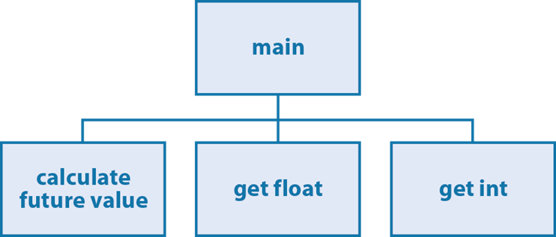
A hierarchy chart for a Future Value program

Slide 20
Testing phase 1: The main() function and the calculate function
Code the calculate_future_value() function.
Code the main() function or at least the portion that calls the calculate_future_value() function and uses the result that’s returned.
Test what you’ve coded so far.

Slide 21
Testing phase 2: Add data validation for float entries
Code the get_float() function.
Modify the main() function so it uses this function to get the float entries.
Test what you’ve coded so far.

Slide 22
Testing phase 3: Add data validation for int entries
Code the get_int() function.
Modify the main() function so it uses this function to get the integer entries.
Test what you’ve coded so far.

Slide 23
Testing phase 4: Add the finishing touches
Make any refinements to the code like improving the prompt messages or the display of the results.

Slide 24
Testing the functions of the Future Value program in the Python shell
>>> new_value = get_float("Enter Number: ", 0, 1000)
Enter Number: 0
Entry must be greater than 0 and less than or equal to 1000.
Enter Number: -1
Entry must be greater than 0 and less than or equal to 1000.
Enter Number: 1001
Entry must be greater than 0 and less than or equal to 1000.
Enter Number: 1000
>>> new_value
1000.0
>>> new_value = get_float("Enter Number: ", 0, 10)
Enter Number: 11
Entry must be greater than 0 and less than or equal to 10.
Enter Number: 10
>>> new_value
10.0
>>> calculate_future_value(100, 12, 1)
1168.2503013196972
>>> calculate_future_value(500, 12, 50)
19528669.849965967
>>>

Slide 25
Testing the functions of the temperature module in the shell
>>> import temperature as t
>>> t.to_celsius(212)
100.0
>>> t.to_fahrenheit(0)
32.0
>>> t.to_celsius(32)
0.0
>>> t.to_fahrenheit(100)
212.0

Slide 26
Testing the functions of the Convert Temperatures program in the shell
>>> convert_temp()
Enter a menu option: 1
Enter degrees Fahrenheit: 212
Degrees Celsius: 100.0
>>> convert_temp()
Enter a menu option: 2
Enter degrees Celsius: 100
Degrees Fahrenheit: 212.0

Slide 27
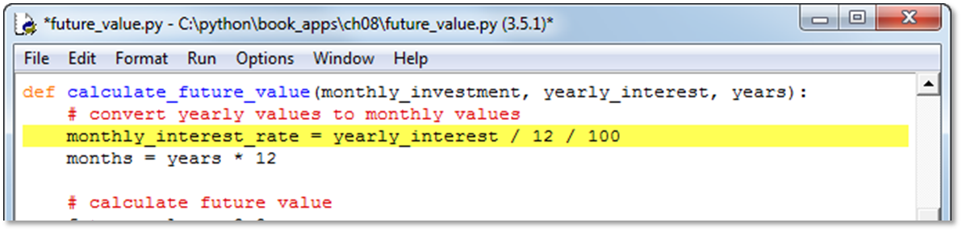
The IDLE editor window with a breakpoint

Slide 28
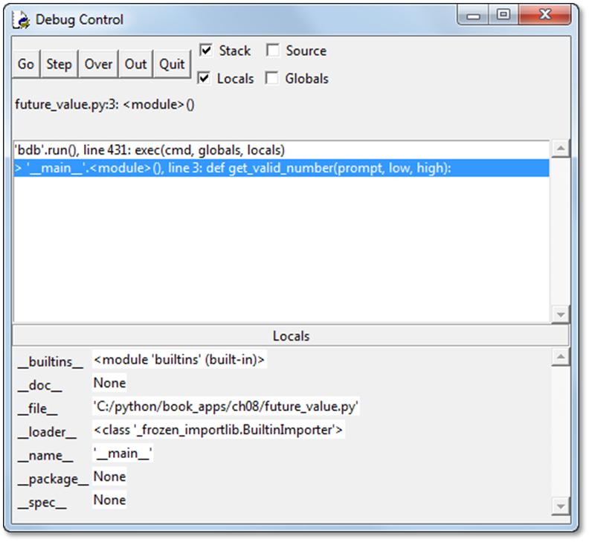
The IDLE Debug Control window when the Future Value program starts

Slide 29
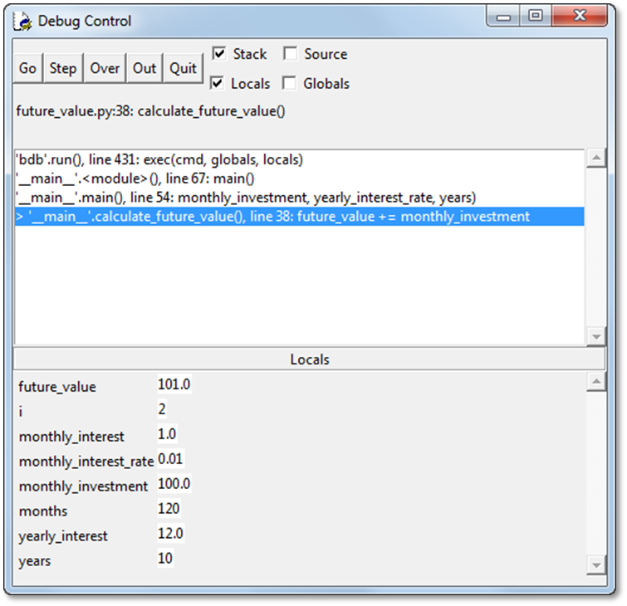
The IDLE Debugger when the Future Value program is running

Slide 30
Some of the buttons on the Debug toolbar
Go
Step
Over
Out
Quit

Slide 31
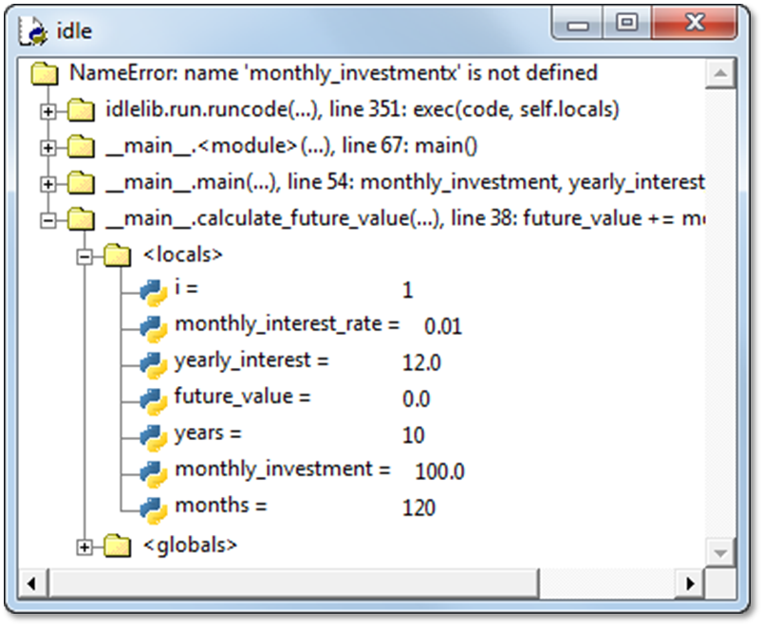
A debugging session with the Stack Viewer window displayed

